Slide 1





Slide 2
WEB PROGRAMMING AND APPLICATION

Slide 3


SECURITY

Slide 4
TÊN NHÓM
NGỮ VĂN
Phân tích văn bản “Vợ Nhặt”
GROUP 9

Slide 5





Group’s members
522H0172
Vũ Minh Quân
522H0120
Nguyễn Đình Việt Hoàng
522H0102
Hoàng Tử Đăng Khoa
522H0165
Trần Thiên Ân

Slide 6





TÊN NHÓM
THÀNH VIÊN NHÓM
HỌ VÀ TÊN
Chức vụ
HỌ VÀ TÊN
Chức vụ
HỌ VÀ TÊN
Chức vụ
HỌ VÀ TÊN
Chức vụ
WEB PROGRAMMING AND APPLICATION
Introduction
What is LSTM?
LSTM
Architecture
The Logic
Behind LSTM
Forget Gate

Slide 7
SECURITY
Introduction
Security Priciples
Motivation
A1 & A2
Typical Implementation
Group’s members
Notes
Injection

Slide 8

Motivation
Tác phẩm
Phương thức
Biểu đạt
Thể loại
Hoàn cảnh
Security is a crucial aspect of web development because the web is a public and open platform that is vulnerable to various types of attacks and threats. Without proper security measures, web applications and websites can be easily compromised, leading to unauthorized access, data breaches, and other malicious activities.

Slide 9



Motivation
Motivation:
A1 & A2
Here are some reasons why we need security in web:
Confidentiality
Integrity
Availability
Compliance
Reputation
Injection
Typycal Implementation
Security Principle
Notes
Group’s member

Slide 10

Motivation
A1 & A2
Two most important concepts in web application securtity are Authentication (AuthN, A1) and Authorization (AuthZ, A2).
Injection
Typical Implementation
Authencation (AuthN, A1)
Security Principle
Authorization (AuthZ, A2)
Notes
Group’s member

Slide 11

A1
Motivation
A1 & A2
Authentication, often referred to as AuthN or A1, is the process of verifying the identity of a user, device, or system. It is a critical component of web security that ensures that only authorized users can access sensitive information and perform specific actions.
Injection
There are several methods of authentication, including:
Something you know: This is the most common method of authentication, which involves asking the user to provide a password, PIN, or other secret information. This method relies on the user's knowledge of the secret to verify their identity.
Something you have: This method involves providing a physical token or device, such as a smart card or security key, that can be used to authenticate the user. This method relies on the user's possession of the token to verify their identity.
Something you are: This method involves using biometric factors, such as fingerprints, facial recognition, or voice recognition, to verify the user's identity. This method relies on the user's unique physical or behavioral characteristics to verify their identity.
Something you do: This method involves analyzing the user's behavior, such as typing patterns or mouse movements, to verify their identity. This method relies on the user's unique behavioral patterns to verify their identity.
Typical Implementation
Security Principle
Notes
Group’s member

Slide 12
A2
Motivation
A1 & A2
Authorization, often referred to as AuthZ or A2, is the process of granting or denying access to specific resources or actions based on the user's identity, role, or permissions. It is a critical component of web security that ensures that users can only access the resources and perform the actions that they are authorized to do.
Injection
Typical Implementation
Authorization can be implemented using various methods, including:
Role-Based Access Control (RBAC): This method involves assigning roles to users based on their job functions or responsibilities, and then granting or denying access to resources based on the user's role. For example, an administrator may have access to all resources, while a regular user may only have access to specific resources.
Access Control Lists (ACLs): This method involves creating a list of users or groups and the resources or actions that they are allowed or denied access to. This method is often used for fine-grained access control, where specific users or groups require access to specific resources or actions.
Capability-Based Access Control (CAPB): This method involves granting users a capability, which is a token or key that grants them access to specific resources or actions. This method is often used in distributed systems, where resources are spread across multiple servers or systems.
Policy-Based Access Control (PBAC): This method involves defining a policy that specifies the rules and conditions for accessing resources or performing actions. This method is often used in complex systems, where access control requirements are dynamic and require a flexible and adaptable approach.
Security Principle
Notes
Group’s member

Slide 13
SQL injection
Motivation
A1 & A2
What is SQL injection?
SQL injection is a technique that allows attackers to execute illegal SQL commands (unforeseen by the developer), by taking advantage of security vulnerabilities in the input data of applications. .
Injection
How Sql Injection Works
Sql injection errors often occur due to a lack of validation of the input data, which causes unwanted effects beyond the main purpose of the query. Let's consider the following query:
Selected_user = "SELECT * FROM users WHERE name = '" + userName + "';"
We see that the main purpose of this query is to search the users table for data rows where the name field has a value equal to the passed userName parameter.
At first glance, this query is structurally correct and does not have any problems, but let's try to analyze the following situation: suppose the caller of this query passes in a valid userName parameter:
a' or 't'='t
So our query can be understood as follows:
SELECT * FROM users WHERE name = 'a' or 't'='t';
What does the above query mean? The WHERE clause of the above query is always true, the reason is because 't'='t' always returns the correct value. So, instead of returning the results of one row of desired data, this query returns the entire data of the users table.
Typical Implementation
Security Principle
Notes
Group’s member

Slide 14
Motivation
Here are some basic web security principles that every web developer should be aware of:
Least privilege principle 10.Never trust the user
Defense in depth 11.Do not harm other (good) user
Secure by design 12.Use HTTP Post instead of HTTP Get
Input validation
Output encoding
Session management
Error handling
Data protection
Security testing
These are just a few of the basic web security principles that every web developer should be aware of. Implementing these principles can help to ensure that web applications and systems are secure, reliable, and resilient to attacks and threats.
A1 & A2
Injection
Typical Implementation
Security Principle
Notes
Group’s member

Slide 15
There are four basic security principles: access, authentication, authorization, and accounting.
Access
Authentication
Authorization
Accounting
Motivation
Use physical and software controls to protect your hardware or data from intrusion.
For hardware, access limits usually mean physical access limits.
For software, access limits usually mean both physical and virtual means.
Firmware cannot be changed except through the Oracle update process.
A1 & A2
Injection
Authentication provides a means to identify a person or entity. Set up all authentication features such as a password system in your platform operating systems to verify that users are who they say they are.
Authentication provides varying degrees of security through measures such as badges and passwords.
Typical Implementation
Security Principle
Authorization defines what an authenticated user or entity can do. Use authorization to ensure company personnel can only work with hardware and software that they are trained and qualified to use.
NHÂN VẬT TRÀNG
NHÂN VẬT THỊ
Notes
Customer IT personnel can use Oracle software and hardware features to monitor login activity and maintain hardware inventories.
Use system logs to monitor user logins. In particular, track system administrator and service accounts through system logs because these accounts can access powerful commands.
Periodically retire or archive log files when they exceed a reasonable size, in accordance with the customer company policy. Log files can become very large over time, so it is essential to maintain them.
Group’s member

Slide 16

There are some important notes about web security
Secure Authentication
Input Validation
Secure Session Management
Cross-Site Scripting (XSS) Prevention
Cross-Site Request Forgery (CSRF) Protection
Secure Communication
Access Control and Authorization
Error Handling and Logging response.
Security Updates and Patching
Security Testing and Auditing
Remember, web security is an ongoing process, and it's essential to stay informed about the latest security best practices and emerging threats to effectively protect your web applications
Motivation
A1 & A2
Injection
Typical Implementaion
Security Principle
Notes
Group’s member

Slide 17
Motivation
Common cases of Sql injection attacks
A1 & A2
Injection
Any application operation that makes a query to the database can be exploited for a Sql injection attack. Basic database operations: select, insert, update can all be attacked. Some common operations that can be attacked include:
Check application login.
Operation to save user comments to DB.
Operation to query user information.
…
Typical Implementation
Security Principle
Notes
Group’s member

Slide 18
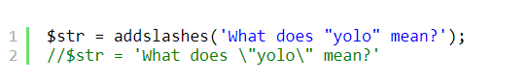
How to prevent Sql injection errors
Motivation
A1 & A2
How to prevent Sql injection errors
As analyzed above: the point of attack is the parameter passed into the query. Therefore, preventive measures must be taken to ensure that checking the transmitted data cannot cause errors when performing queries.
The solution to this check is to use “ escape strings ”. When escaping a string, it means encoding the special characters of the string (such as ', &, |, ...) so that it is no longer understood as a special character. Every programming language provides functions to escape strings, with PHP we will use the mysqli_real_escape_string() function or we can also use addslashes() to do this.
Example of the addslashes() function: double quotes are no longer interpreted as control characters.
Injection
Typical Implementation
Security Principle
Notes
Group’s member

Slide 19
Motivation
XSS attack (cross-site scripting)
A1 & A2
What is XSS?
XSS is an attack technique in which the attacker inserts malicious client-script code (usually javascript or HTML ) into the website, which will be executed when the user accesses and loads the page. contains malicious code.
Unlike Sql injection where malicious code is executed on the server, XSS is a form of attack in which malicious code is executed on the client machine. Because the malicious code is contained on the server but executed on the client, this technique is called "cross-site".
Injection
Typical Implementation
Security Principle
How XSS works
XSS can be divided into two types: Stored-XSS and Reflected-XSS. Both are sending malicious code to the client computer for execution, specifically displaying content generated during website operation, however the methods are slightly different as follows:
Notes
Group’s member

Slide 20
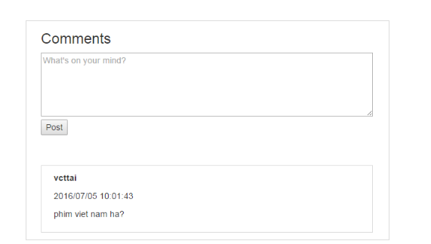
Stored-XSS
Motivation
This type of XSS attack takes advantage of website security vulnerabilities to store malicious code on the server. Every time a user downloads the page, this malicious code will be executed. The most typical of this type of attack is to take advantage of points containing user input data such as: comment boxes on blog pages, boxes to fill in the content of public account information, ...
Suppose our website has a comment text input box as follows:
A1 & A2
Injection
Typical Implementation
Security Principle
Notes
Group’s member

Slide 21
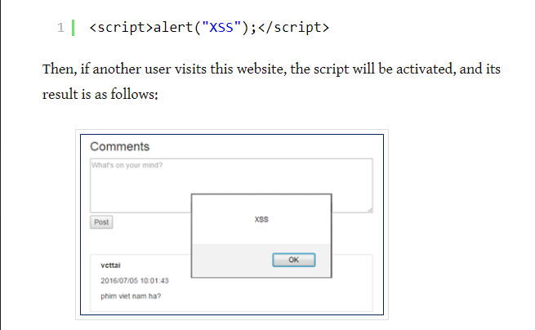
Stored-XSS
Motivation
Instead of entering comments as usual, the attacker will insert malicious code, for example the following script:
A1 & A2
Injection
Typical Implementation
Security Principle
Notes
Group’s member

Slide 22
Stored-XSS
Motivation
A1 & A2
The above is just a simple example of an XSS attack technique. Of course, the attacker can insert more dangerous code to exploit user information. We see that, although this malicious code is stored on the server, it is executed on the client's computer, so it is called stored-XSS.
Injection
Reflected-XSS
Typical Implementation
In this attack technique, malicious code is attached directly to the website link. Once you access the link containing malicious code, the malicious code will be executed.
Suppose we have the following website link:
xyz.abc.vn/xss/reflected/index?qid=alert(‘XSS’);
If this website uses the value of the qid parameter to display, then when accessing this link, we will receive an XSS error.
Security Principle
Notes
Group’s member

Slide 23
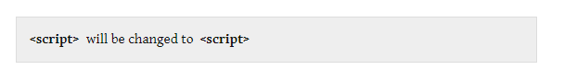
Ways to avoid XSS
Motivation
A1 & A2
As mentioned above, the key to this attack technique lies in displaying the content entered on the client , so to prevent it, we will strictly control the places where content can be displayed.
Similar to how to prevent Sql injection, every time we receive data, we will check and encode special characters and control characters that pose a risk of harm to the program. Then special characters will be transformed similarly to the following:
Injection
Typical Implementation
Security Principle
Notes
To do this, before displaying certain information in an HTML tag, we always perform escape first on the server to convert special characters into html entities (in PHP we can use the htmlentities() function to do this).
Group’s member

